Slide 1
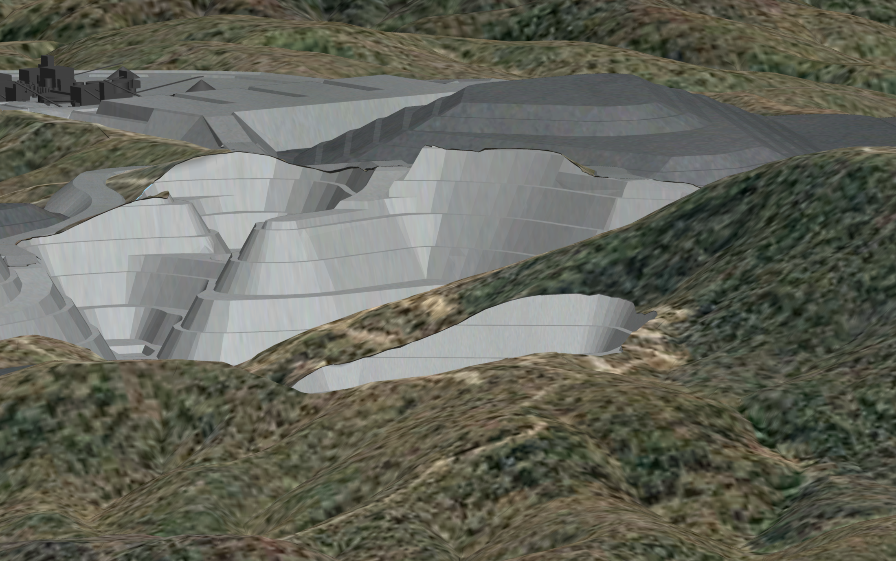
VITAL METALS
Watershed tungsten project
De-risked and ready for development
RRS Investor Luncheon Series 17 February 2015
ASX:VML
Building a globally significant strategic metals company

Slide 2
Forward Looking and Cautionary Statements
Forward looking statements
Certain written statements contained or incorporated by reference in this presentation, including information as to the future financial or operating performance of the Company and its projects, constitute forward-looking statements. All statements, other than statements of historical fact, are forward-looking statements. The words “believe”, “expect”, “anticipate”, “contemplate”, “target”, “plan”, “intend”, “continue”, “budget”, “estimate”, “may”, “will”, “schedule” and similar expressions identify forward-looking statements.
Forward-looking statements include, among other things, statements regarding targets, estimates and assumptions in respect of tungsten, gold or other metal production and prices, operating costs and results, capital expenditures, mineral reserves and mineral resources and anticipated grades and recovery rates. Forward-looking statements are necessarily based upon a number of estimates and assumptions related to future business, economic, market, political, social and other conditions that, while considered reasonable by the Company, are inherently subject to significant uncertainties and contingencies. Many known and unknown factors could cause actual events or results to differ materially from estimated or anticipated events or results reflected in such forward-looking statements. Such factors include, but are not limited to: competition; mineral prices; ability to meet additional funding requirements; exploration, development and operating risks; uninsurable risks; uncertainties inherent in ore reserve and resource estimates; dependence on third party smelting facilities; factors associated with foreign operations and related regulatory risks; environmental regulation and liability; currency risks; effects of inflation on results of operations; factors relating to title to properties; native title and aboriginal heritage issues; dependence on key personnel; and share price volatility and also include unanticipated and unusual events, many of which are beyond the Company's ability to control or predict.
For further information, please see the Company's most recent annual financial statement, a copy of which can be obtained from the Company on request or at the Company's website: www.vitalmetals.com.au. The Company disclaims any intent or obligation to update any forward-looking statements, whether as a result of new information, future events or results or otherwise. All forward-looking statements made in this presentation are qualified by the foregoing cautionary statements. Investors are cautioned that forward-looking statements are not guarantees of future performance and, accordingly, not to put undue reliance on such statements.
Cautionary Statement
The Definitive Feasibility Study (DFS) referred to in this presentation is based on a Proved and Probable Ore Reserve derived from a Measured and Indicated Mineral Resource, plus a small proportion of mining inventory, which comprises material that is currently classified as Inferred Mineral Resource. There is a low level of geological confidence associated with Inferred Mineral Resources and there is no certainty that further exploration work will result in the determination of Indicated Mineral Resources or that the production target itself will be realised. The Company advises that the Proved and Probable Ore Reserve provides 93% of the total tonnage and 93% of the total WO3 metal underpinning the forecast production target and financial projections, and that the additional life of mine plan material comprises less than 7% of the total tonnage and WO3 metal. Furthermore, in the first five years of production, 95% of the material planned to be processed is based on Proved and Probable Ore Reserves. As such, the dependence of the outcomes of the DFS and the guidance provided in this announcement on the lower confidence Inferred Mineral Resource material contained in the life of mine plan is minimal. The Company confirms that all the material assumptions underpinning the production target, and the forecast financial information derived from the production target continue to apply and have not materially changed.

Slide 3
Investment Highlights
Watershed Tungsten Project: positive Feasibility Study completed *
Annual EBITDA of A$50M from 2.5Mtpa project
Pre-production capital of US$138M including contingencies
World-class JORC resource: DFS considered 10-year open pit operation with only ~40% of resources extracted plus significant near-mine exploration potential
Clear pathway to development in 2015, subject to completion of project finance
Simple open cut mining operation 115km NW of Cairns, North Queensland
Project fully permitted: all Mining Leases, Environmental Authority and Indigenous Land Use Agreement in place
Tungsten is a strategic metal which is on strong demand: no viable substitute
Watershed scheelite ore can be processed into readily saleable concentrate using a simple metallurgical process involving ore sorting, spirals and flotation
Potential funding solution via partnership with JOGMEC (30% interest): expected to transfer its interest to Japanese company that will have an off-take interest and responsibility for arranging its share of project finance, plus potentially assist in financing Vital’s share of funding
ASX release 17 September 2014, ASX release 22 January 2015
See Forward Looking and Cautionary Statements

Slide 4
Company Overview and Structure
Capital Structure
ASX Code: | VML
Share price: | A$0.034
Shares on Issue: | 304M
Options on Issue: | 80M
Market Cap (undiluted): | ~A$10.4M
*As at 13 February 2015
Directors
David Macoboy – Chairman
Mark Strizek - Managing Director
Peter Cordin – Non-Exec Director
Andrew Simpson - Non-Exec Director
Management
Ian Hobson – Company Secretary Jamie Williamson – Exploration Manager Bayili Paul Pérré - Logistics Manager (Burkina Faso)

Slide 5
Tungsten – a Vital Metal with Strategic Importance
Tungsten (chemical symbol W) is a corrosion-resistant, dense material with the highest melting point of any metal and is sought for both its mechanical and refractory properties.
It is the 2nd hardest known substance in the form of tungsten carbide
Virtually no substitution for many of its applications
Its most important use is in cemented carbides (hardmetals), used in high-speed tools and drill bits for the hydrocarbon and mining sectors.
Tungsten market prices are set in reference to the price of Chinese ammonium paratungstate (APT) an intermediary product. Tungsten products are not traded on the London Metals Exchange.
Tungsten pricing is based on the Metric Ton Unit (MTU), which is equal to 1% of a metric ton, or 10 kilograms
World supply is dominated by China, which produced 86% of tungsten in 2012
Tungsten has been classified as a critical and strategic mineral by the British Geological Survey, the European Commission, the United States Government and the Government of China.
Automotive Industry.
Tungsten carbide based tools used to manufacture automobile parts
Industrial Engineering.
Cutting tools used in all areas thanks to robustness, strength and wear resistance
Mining & Road Construction
Strength and wear resistance make carbide tools the first choice in this industry
Aviation
Hi-tech materials worked using tungsten tools
Energy
Needs high wear resistance tungsten carbide tools

Slide 6
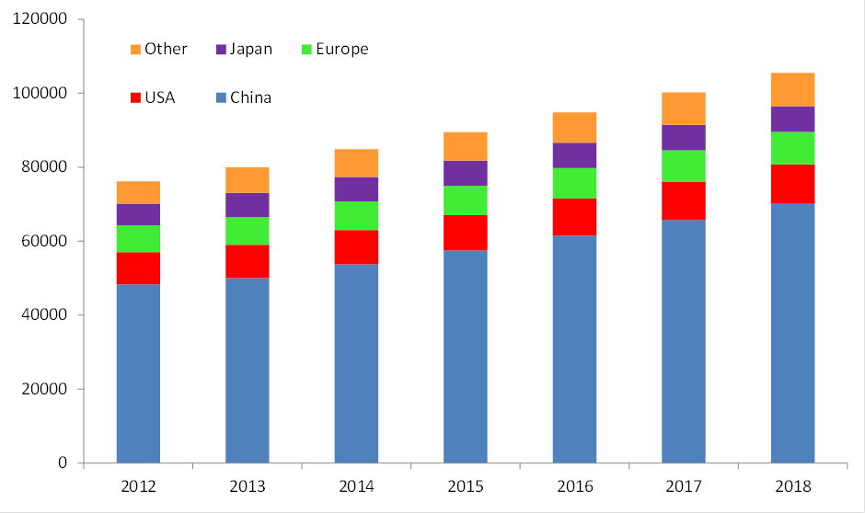
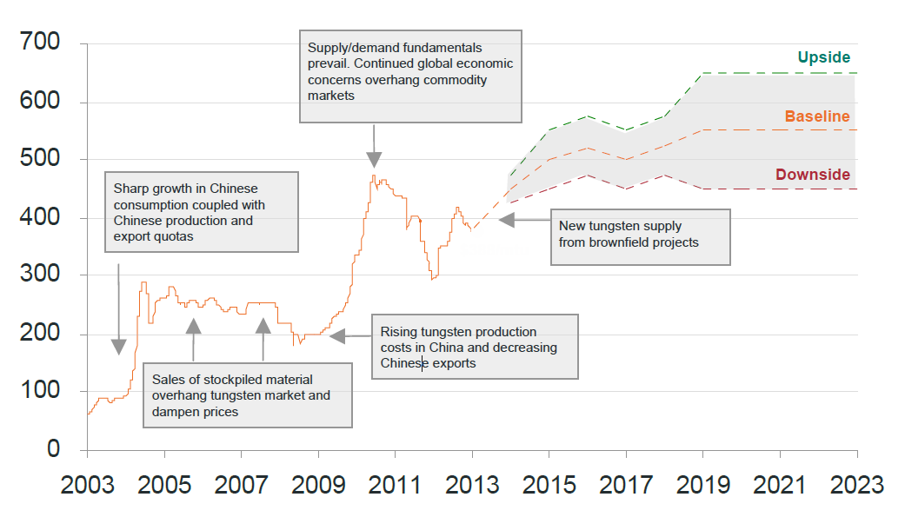
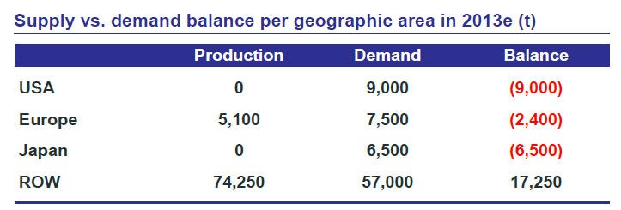
Tungsten Demand Expected to Grow
World forecast demand by country (tonnes W)
Market fundamentals for tungsten are strong with market forecasters predicting that tungsten supply will decrease by around 3% over the period 2015-2017.
Demand on the other hand is expected to grow at 6% over the same period. This is expected to result in a shortfall in the supply/demand balance over the period 2015-2018.
The industry in China and Europe to an extent is vertically integrated as metal producers forge links with domestic raw material suppliers to underpin their industry.
In this environment, globally significant metal makers that fail to secure access to supply of raw material are at considerable strategic risk.
Source: Tungsten Market Research
Tungsten APT Prices US$/mtu
Source: Tungsten Market Research
Source: Tungsten Market Research

Slide 7
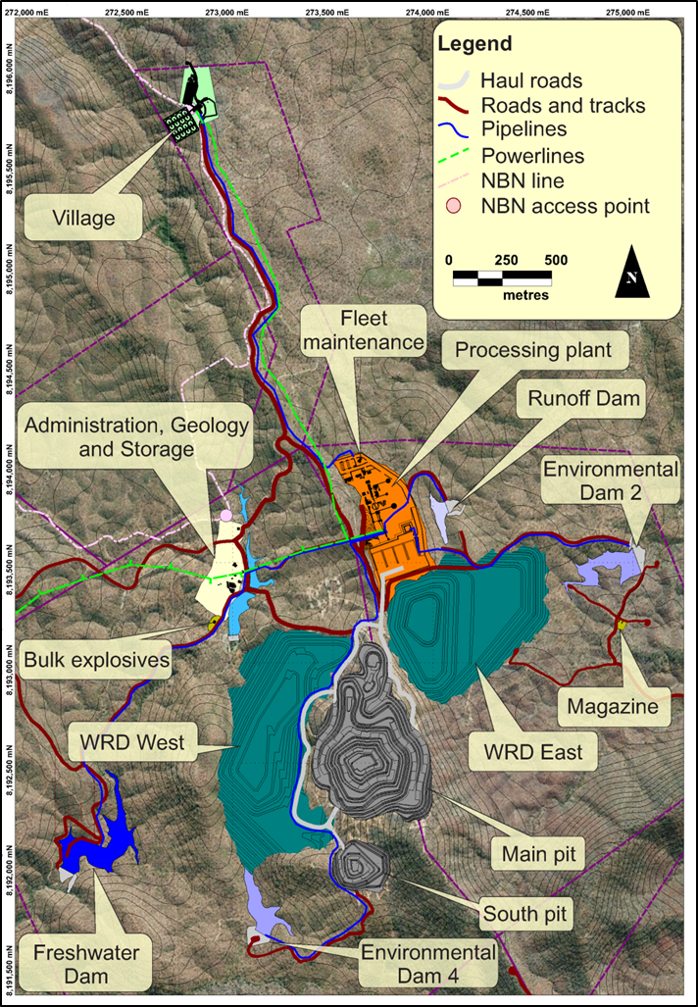
Watershed Project
Located 115km north west of Cairns
Access to international and domestic airport at Cairns
Well serviced with road, state grid power line (24km from site)
Creating employment for 300 people during construction
Employing 120 people when in operation
Providing additional benefits to Queensland via royalties and payroll taxes.

Slide 8
Watershed Mineral Resources and Ore Reserves
Mineral Resources | Tonnage Mt | WO₃%
Measured | 9.5 | 0.16
Indicated | 28.4 | 0.14
Sub Total: Measured and Indicated | 37.8 | 0.15
Inferred | 11.5 | 0.15
Total: Measured, Indicated and Inferred | 49.3 | 0.14
Ore Reserves | Tonnage Mt | WO₃%
Proved | 6.4 | 0.16
Probable | 15 | 0.14
Total: Proved and Probable | 21.3 | 0.15
Notes to accompany Mineral Resources and Ore Reserves
Mineral Resources first reported in ASX release 30 July 2012
Ore Reserves first reported in ASX release 17 September 2014
Mineral Resources are inclusive of Ore Reserves
Mineral Resources and Ore Reserves reported at a cut-off grade of 0.05% WO₃
Please refer to Competent Persons statement accompanying this presentation

Slide 9
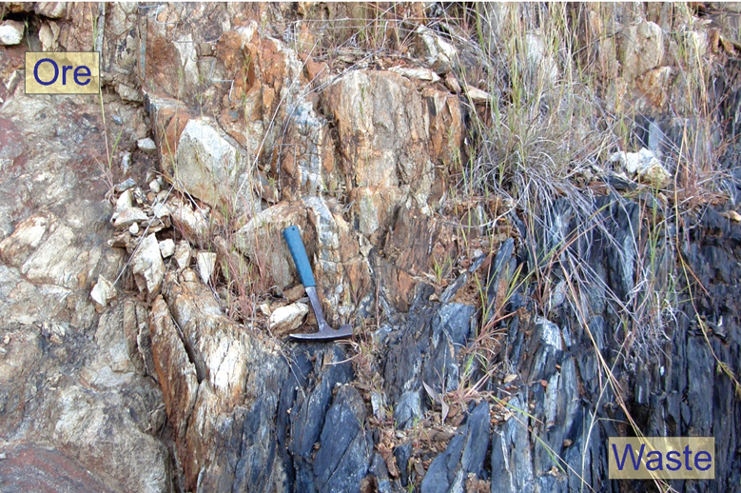
Mine Plan and Production Schedule
10 year mine life: 9 years mining, after which low grade stockpiles will be processed.
Mine production scheduled to feed a 2.5Mtpa processing plant.
Open cut mining using 200t hydraulic excavator and 5 x 100t dump trucks.
Highly visible ore – assists with selective mining.
Material | Units | 1 | 2 | 3 | 4 | 5 | 6 | 7 | 8 | 9 | 10 | Total
Waste Tonnes Mined | Mt | 7.1 | 9.65 | 8.9 | 8.82 | 8.23 | 7.63 | 7.22 | 6.01 | 2.31 | 0.36 | 66.23
Ore Tonnes Processed | Mt | 2.22 | 2.5 | 2.5 | 2.5 | 2.5 | 2.5 | 2.5 | 2.5 | 2.5 | 0.84 | 23.06
WO3 Head Grade | % | 0.18 | 0.17 | 0.19 | 0.13 | 0.13 | 0.11 | 0.12 | 0.12 | 0.17 | 0.15 | 0.15
WO3 Tonnes Produced | Kt | 2.98 | 3.19 | 3.54 | 2.29 | 2.3 | 2.05 | 2.2 | 2.29 | 3.09 | 0.96 | 24.89

Slide 10
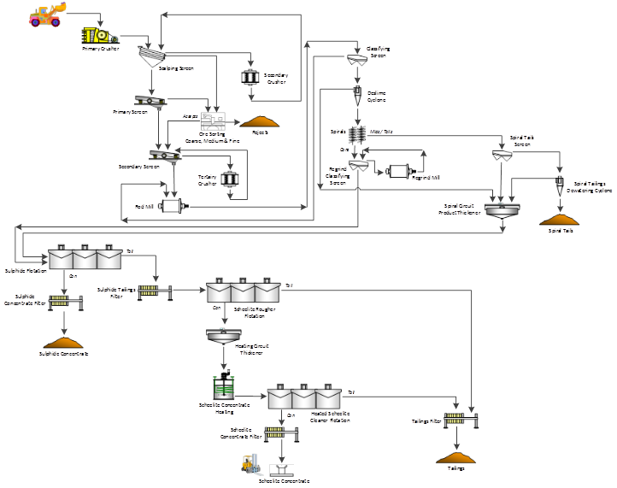
Processing Flowsheet
High grade 65% WO₃ clean concentrate produced at an average plant recovery of 73.6% WO₃.
Throughput of 2.5Mtpa for 2,500tpa WO₃ in concentrate life of mine.
Flowsheet minimises power consumption. Ore sorters and spirals reject 80% of the feed prior to flotation.

Slide 11
Project Capital and Operating Costs
Project Capital Cost Estimates |  | A$M | US$M
Mining |  | 2.2 | 1.8
Processing Plant |  | 130.5 | 104.4
Site Infrastructure |  | 36.2 | 29.0
Working Capital |  | 3.4 | 2.7
Total |  | 172.3 | 137.8
C1 Cash Cost Estimates – Life of Mine | A$/ t ore | A$/mtu | US$/mtu
Mining | 12.8 | 111 | 89
Processing | 7.5 | 69 | 55
Administration and Transport Charges | 1.5 | 14 | 11
C1 Cash Cost | 20.9 | 194 | 155
Notes to accompany Capital and Operating Costs
Updated DFS figures reported in ASX release 22 January 2015
An exchange rate of A$1:US$0.80 has been assumed
Capital costs are on an 100% equity basis
Operating costs are on a life of mine basis
See accompanying Forward Looking and Cautionary Statements

Slide 12
Watershed Financials
Project Returns | APT US$325/mtu FX US$0.80 |  | APT US$350/mtu FX US$0.80 |  | APT US$375/mtu FX US$0.80 |  | APT US$400/mtu FX US$0.80 |  | APT US$450/mtu FX US$0.80
 | Pre Tax | Post Tax | Pre Tax | Post Tax | Pre Tax | Post Tax | Pre Tax | Post Tax | Pre Tax | Post Tax
NPV @ 8% | $63M | $31M | $111M | $65M | $160M | $100M | $207M | $132M | $300M | $200M
IRR | 16.0% | 12.3% | 21.5% | 16.6% | 26.8% | 20.6% | 31.7% | 24.5% | 40.8% | 31.6%
Payback Years |  | 4.8 |  | 3.4 |  | 2.8 |  | 2.5 |  | 2.1
Free Cashflow | $184M | $130M | $259M | $182M | $335M | $235M | $410M | $288M | $561M | $394M
Cash Costs US$/ mtu | 156
Total Costs US$/ mtu | 212
Notes: Figures reported in ASX release 22 January 2015 and are on a 100% equity basis. Operating costs are on a life of mine basis. Please refer to accompanying Forward Looking and Cautionary Statements

Slide 13
Opportunities
Additional Project life:
Potential for an underground operation – ore body open at depth
Potential for satellite surface operations at Desailly and Watershed South – drill ready exploration targets
Pipeline of exploration prospects within trucking distance of proposed plant
Processing Plant:
Optimisation of process recovery post ramp-up.
Test work suggests that average recoveries could increase to ~77% WO₃ -additional savings in Capex and Opex
Financial:
Further deprecation of the Australian dollar against the US dollar may result in improved returns over forecasts
Resetting of Australian resources cost base may flow into reduced Capital and Operating costs
Note: Subject to further exploration and confirmatory studies

Slide 14
Summary
Watershed Tungsten Project is ready to go
Strategic project level partnership with JOGMEC (30% interest in project) key to securing involvement of Japanese company that will provide off-take and assist with project financing
Good opportunity to build on the 10-year open pit operation identified in Feasibility Study
Significant exploration potential to add additional mineral resources near to the proposed mine development
Clear pathway to commence development in 2015, subject to successful completion of project finance
Transfer of JOGMEC Interest to JV Partner
Project Financing
Construction
Mining
On track to build a substantial Australian strategic metals company…

Slide 15
Competent Person Statements
Competent Person’s Statement
The information that refers to Mineral Resources in this presentation was prepared and first disclosed under the JORC Code 2004. It has not been updated since to comply with the JORC Code 2012 on the basis that the information has not materially changed since last reported.
The information in this report that relates to Exploration Targets, Exploration Results, Mineral Resources or Ore Reserves is based on information compiled by Mr Mark Strizek, a Competent Person who is a Member or The Australasian Institute of Mining and Metallurgy. Mr Strizek is a full time employee of the Company. Mr Strizek has sufficient experience that is relevant to the style of mineralisation and type of deposit under consideration and to the activity being undertaking to qualify as a Competent Person as defined in the 2012 edition of the “Australasian Code for Reporting of Exploration Results, Mineral Resources and Ore Reserves”. Mr Strizek consents to the inclusion in the announcement of the matters based on his information in the form and context in which it appears.
The information in this presentation that relates to Mineral Resources for the Watershed Deposit is based on information evaluated by Mr Simon Tear who is a Member of The Australasian Institute of Mining and Metallurgy (MAusIMM) and who has sufficient experience relevant to the style of mineralisation and type of deposit under consideration and to the activity which he is undertaking to qualify as a Competent Person as defined in the 2012 edition of the “Australasian Code for Reporting of Exploration Results, Mineral Resources and Ore Reserves”. Mr Tear is a Director of H&S Consultants Pty Ltd and he consents to the inclusion of the estimates in the report of the Mineral Resource in the form and context in which they appear.
This Ore Reserves statement has been compiled in accordance with the guidelines defined in the Australasian Code for Reporting of Exploration Results, Mineral Resources and Ore Reserves (JORC Code – 2012 Edition). The Ore Reserves have been compiled by Mr Steve Craig of Orelogy Group Pty Ltd, who is a Fellow of Australasian Institute of Mining and Metallurgy. Mr Craig has had sufficient experience in Ore Reserve estimation relevant to the style of mineralisation and type of deposit under consideration to qualify as Competent Person as defined in the 2012 Edition of the “Australasian Code for Reporting of Mineral Resources and Ore Reserves”. Mr Craig consents to the inclusion in the presentation of the matters based on his information in the form and context in which it appears.

Slide 16
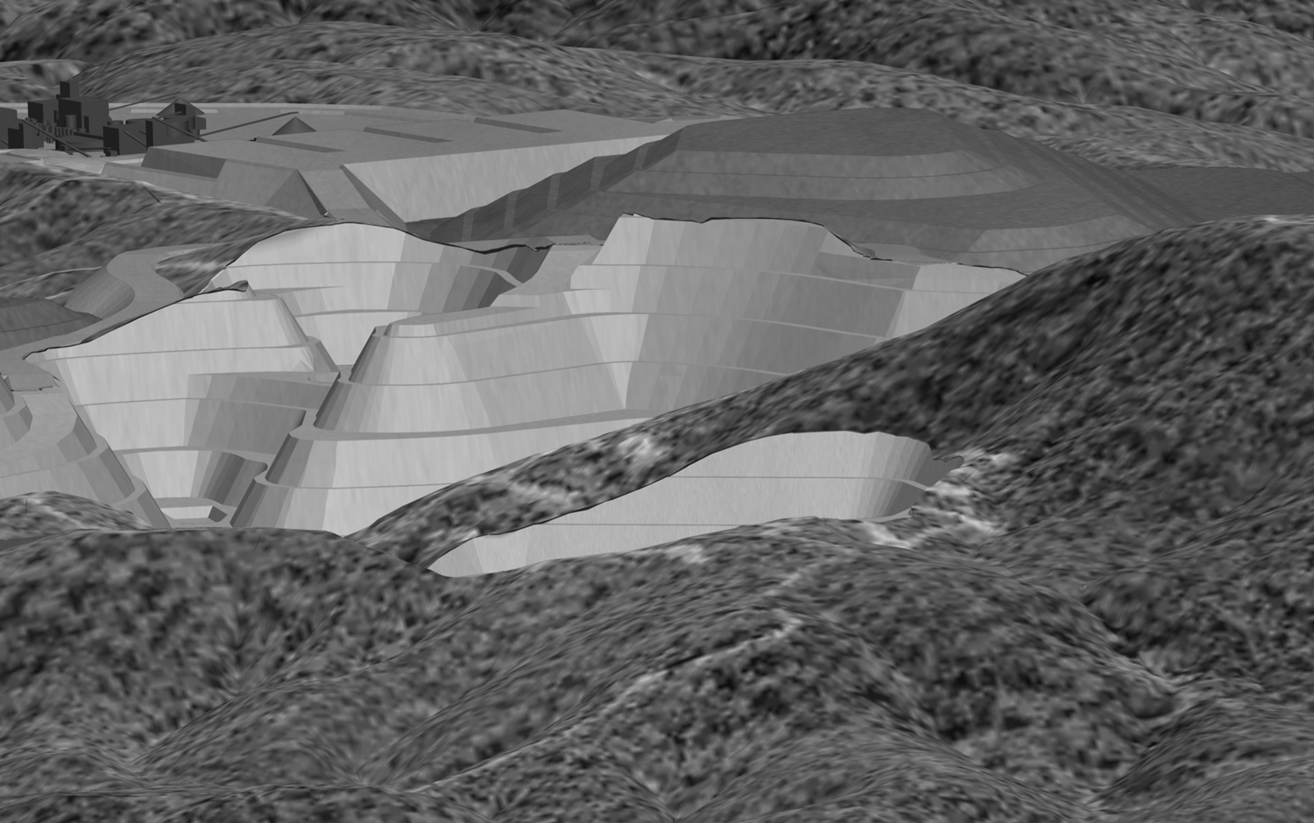
For Further Information
Mark Strizek – Managing Director
Ph: +61 8 9388 7742
Email: vital@vitalmetals.com.au
ASX:VML
Building a globally significant strategic metals company

Slide 17
Appendix
Building a globally significant strategic metals company

Slide 18
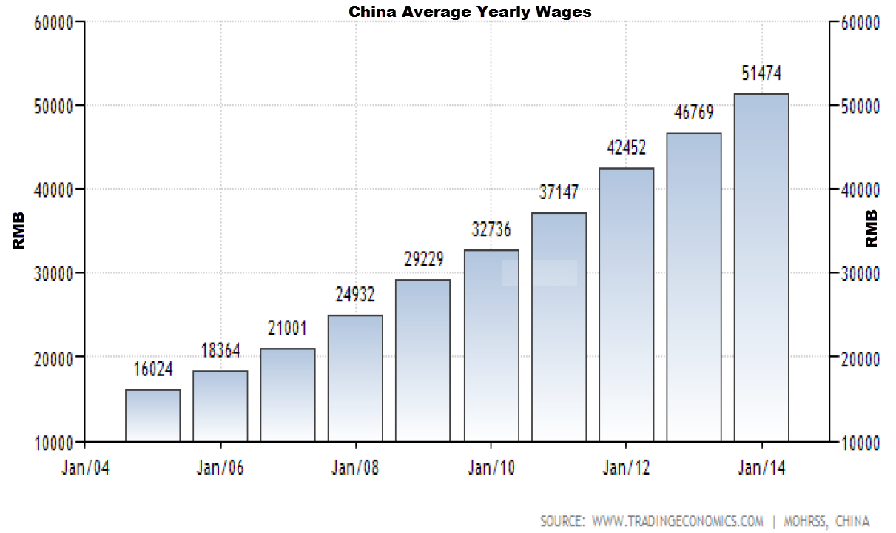
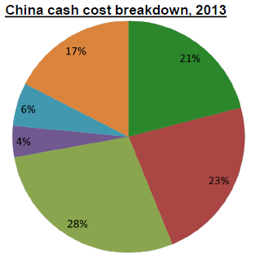
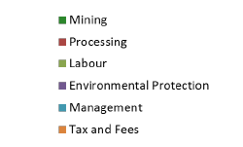
China – Focused on Domestic Needs First
China is the largest consumer and producer of tungsten.
China accounts for 85% of the world’s total output and 55% of the global demand.
Chinese production is focused towards domestic supply and value added products leading to a structural market shift.
Export of concentrate is banned and export of ATP is restricted via an export quota.
China is the largest importer of tungsten concentrate with greater than ~50% of world demand.
China exports intermediary and downstream products (70/30 respectively).
China has stated its goal is to move downstream into the high value in-use end of the market (hardmetals).
Costs in China are continuing to rise, decreasing Chinese competitiveness.
Average site cash costs for a typical Chinese operation were estimated to be around US$165/mtu to produce a 65% WO₃ concentrate in 2013.
Chinese Average Yearly Wages
Source: Roskill

Slide 19
Watershed – Well Placed to Meet Japan’s Tungsten Needs
Japan has a world class tungsten industry that produces high technology tungsten metal products for domestic and international consumption.
Japan has no domestic tungsten mining industry and relies 100% on imports to supply its industry.
Production of tungsten products in Japan is dominated by Mitsubishi and Sumitomo group companies.
Production is focused on carbide tooling, primarily for the automotive industry in Japan and internationally.
Mitsubishi and Sumitomo group companies have conversion facilities that can convert tungsten concentrate into intermediary products such as APT.
Tungsten stockpiles in Japan have steadily decreased since 2012 and are now at low levels representing around 60 days of production.
“Japan currently relies on tungsten imports from China to support its domestic tungsten industry”.

Slide 20
Exciting Exploration Potential
Name | Tenement | Element of Interest | Tonnage Range (kt) | Grade Range | Comments
Watershed Deeps* | ML20536 | W | 10,500 – 14,000 | 0.14 - 0.25% | These Exploration Targets are conceptual in nature, and there has been insufficient exploration to define a Mineral Resource. It is uncertain if further exploration will result in the estimation of a Mineral Resource.
Watershed South* | MDL127 | W | 830 - 1,000 | 0.06 - 0.15%
Desailly North* | MDL127 | W | 830 - 1,000 | 0.06 - 0.15%
Desailly* | MDL127 | W | 1,150 – 1,500 | 0.06 - 0.15%
Mt Elephant* | EPM 14735 | W, Sn | 1,000 - 3,000 | 0.06 - 0.15%
Slaty Range* | EPM 25102 | W, Sn | 35,000 – 60,000 | 0.10-0.18%
Exploration Potential exclusive of current Mineral Resource |  | W | 49,000 – 80,000 | 0.10-0.19%
Notes to accompany Exploration Potential
Exploration Targets reported 25 November 2013, AGM Presentation. Slaty Range reported 13 October 2014.
Please refer to Competent Persons statement accompanying this release.

Slide 21
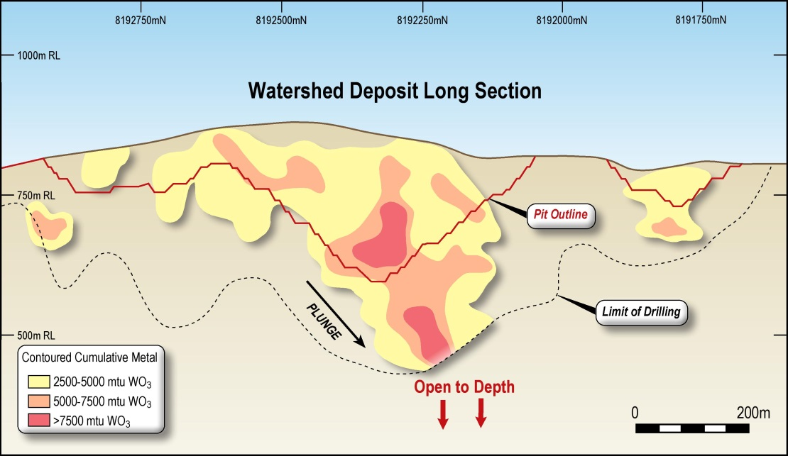
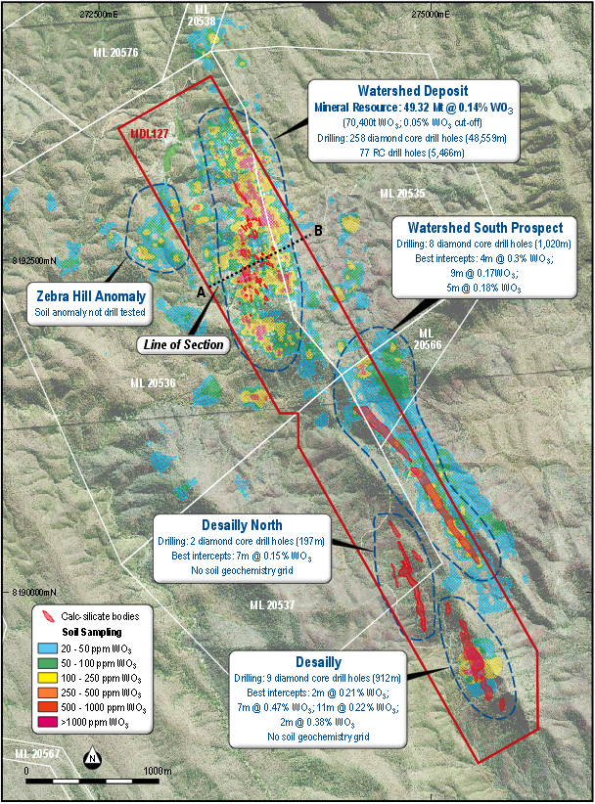
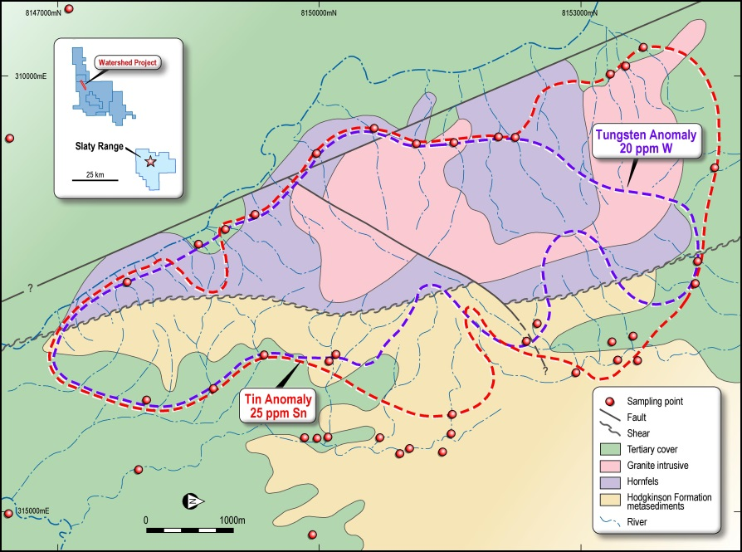
Exploration Pipeline to Drive Growth
Watershed Deeps
Slaty Range

